Slide 1






Sexual Health Board Report
@myhqtoronto | hqtoronto.ca | hqtoronto.ca/donate
@myhqtoronto | hqtoronto.ca | hqtoronto.ca/donate

Slide 2
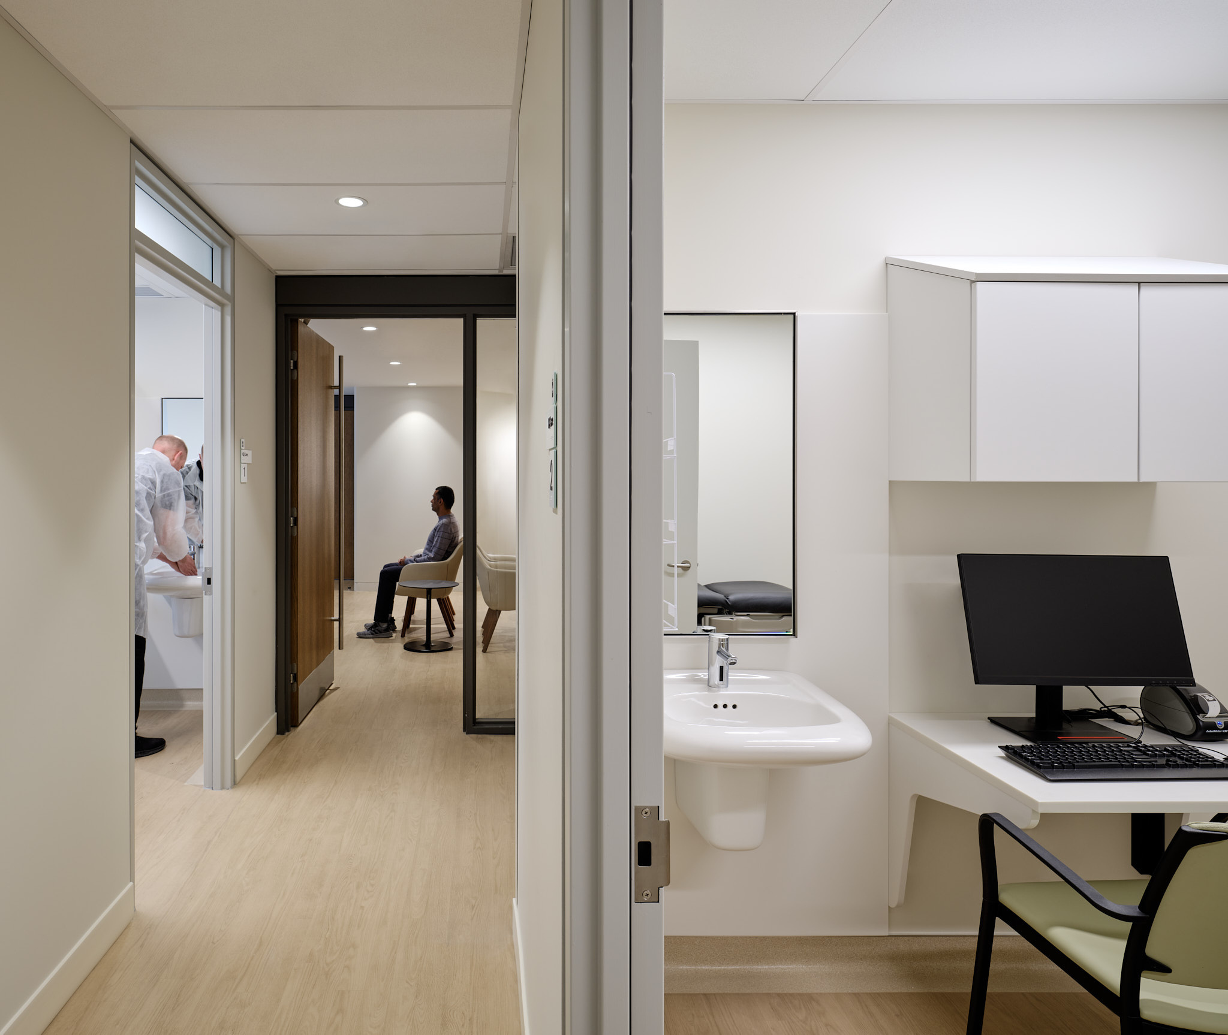
Highest weekly average last week
178 sexual health visits / day
Highest number of daily service users on Monday July 8, 2024 at 220 users
New visits have stabilized.
Our testing is significantly less expensive than Public Health.
Successful Code for Canada Hackathon
Idea 1:
Improve kiosk check-in process
Idea 2:
Automate mass sending of all negative results (80% of patients)
Sexual Health
Key Messages
July 2024
@myhqtoronto | hqtoronto.ca | hqtoronto.ca/donate

Slide 3

The problem
How might we make it easier for HQ Toronto patients to know where they are in the check-in and triage process so that they feel more informed?

Slide 4

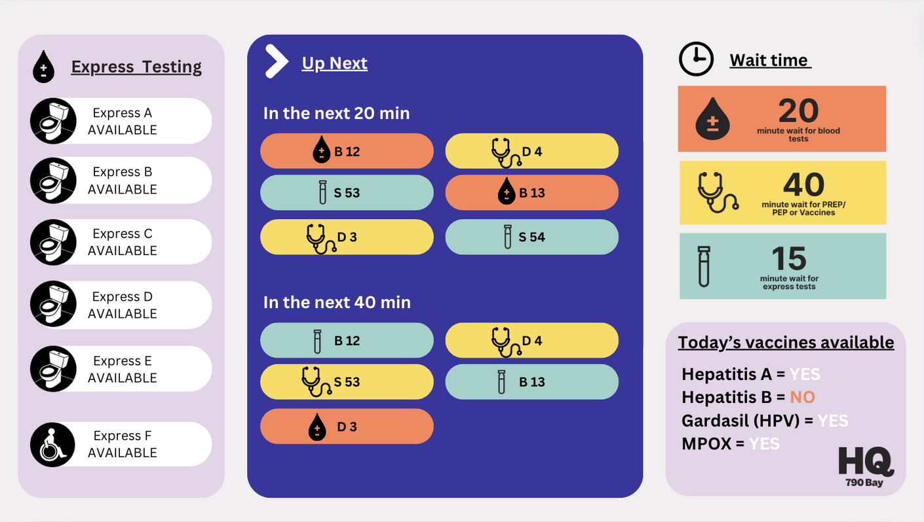
V4

Slide 5
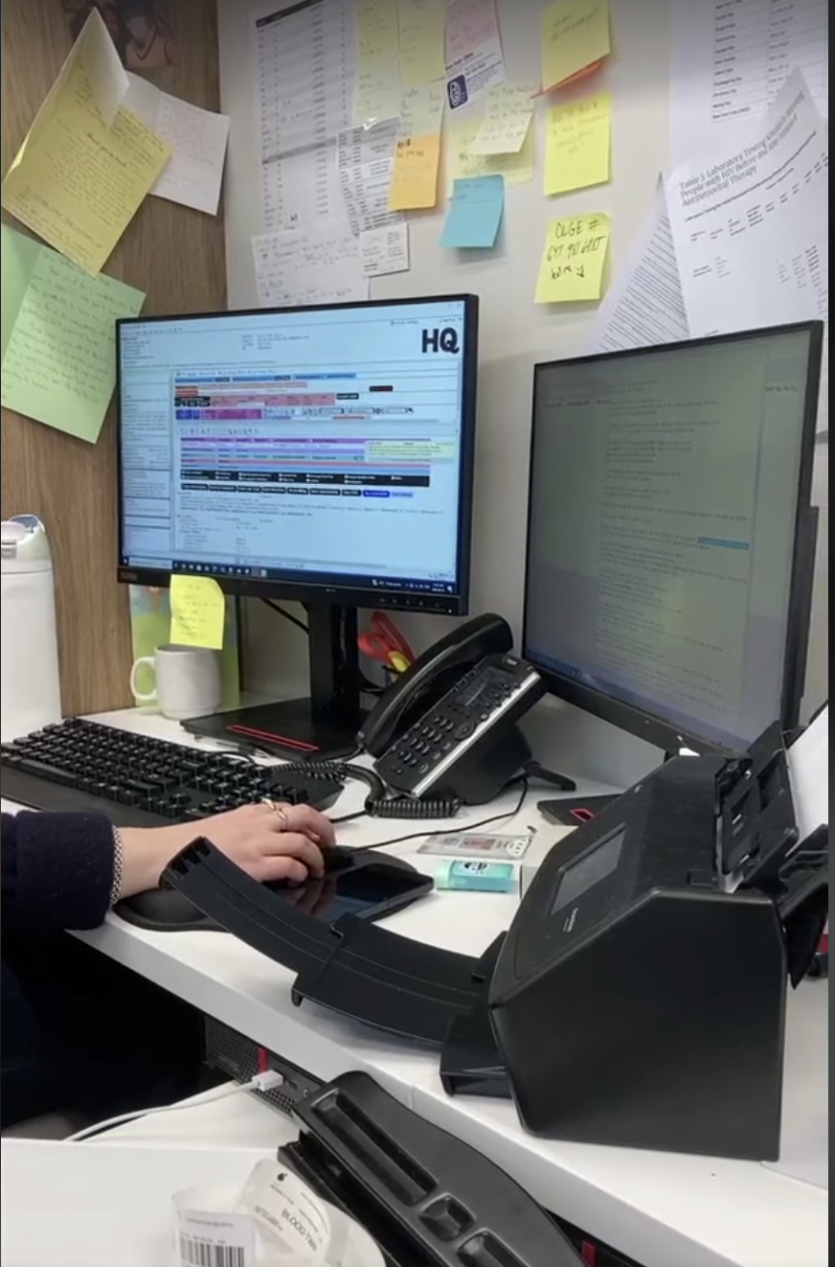

The problem
What is the problem?
Tasks nurses spend a lot of time sending negative test results to patients, which could be better used for delivering care to patients.
Why is this important?
Lead to increased employee burnout
Reduced patient care
Results not shared quickly
Reduced level of patient care

Slide 6
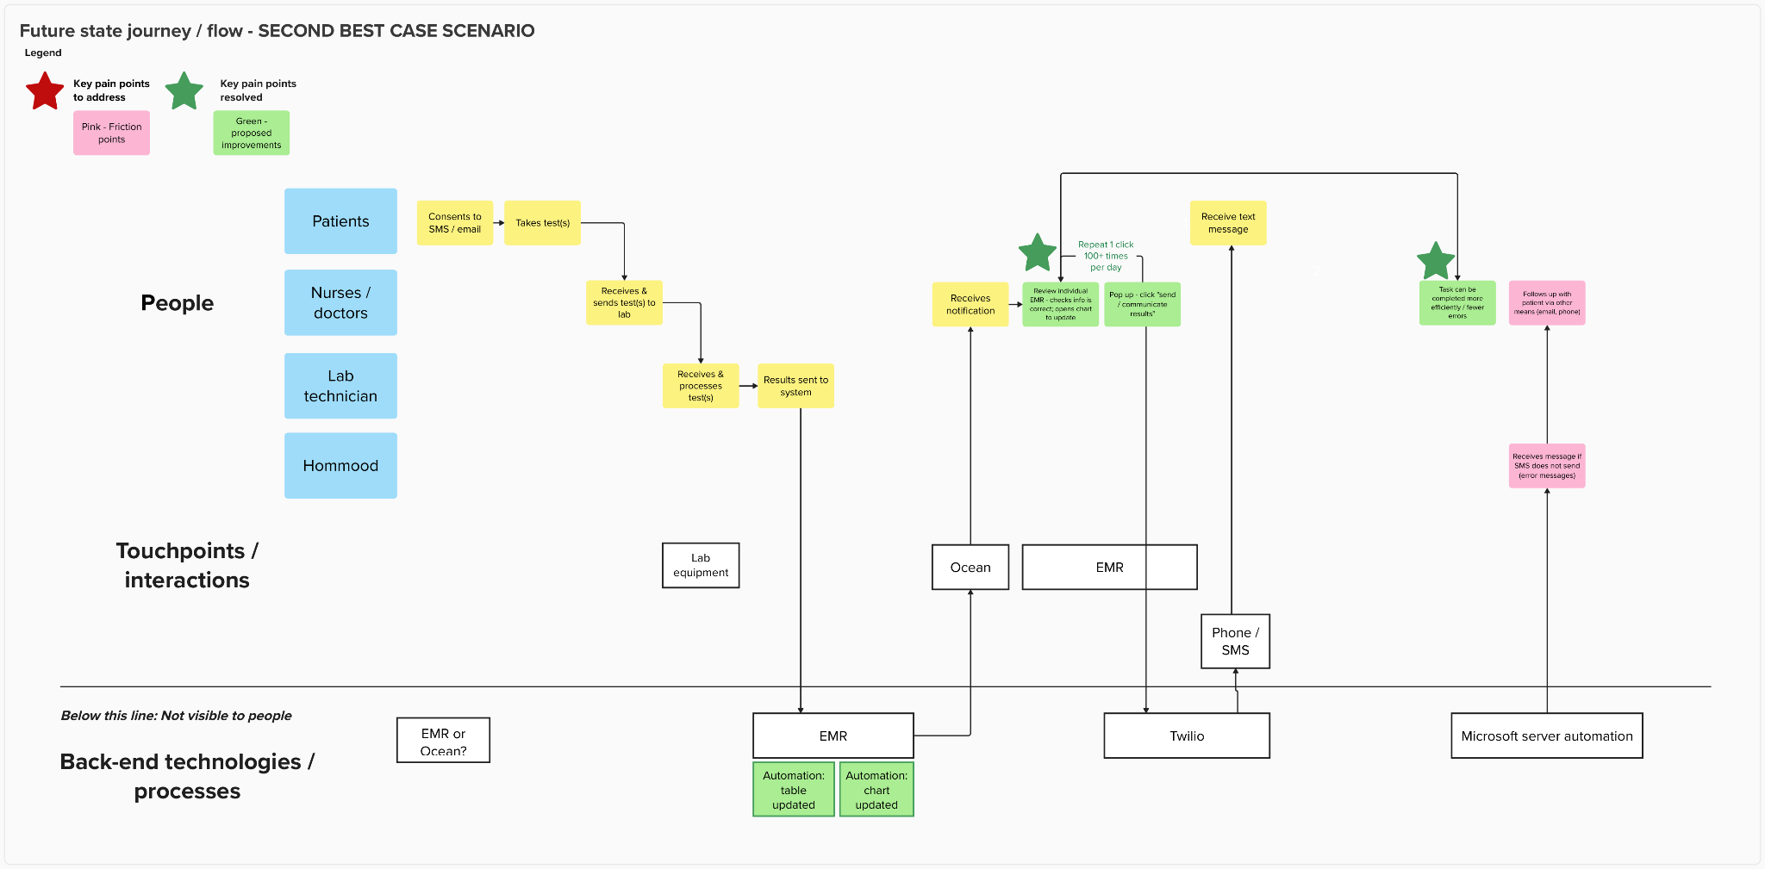
Future state: Texting a negative test result

Slide 7
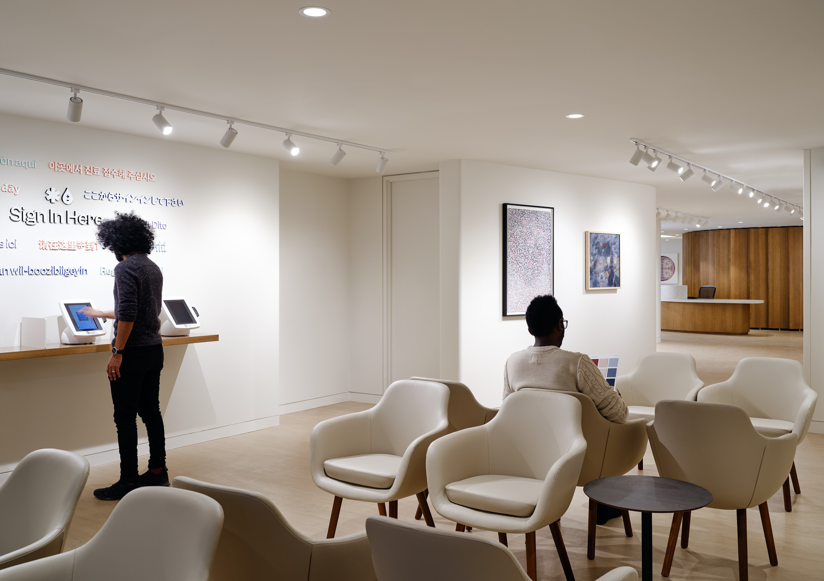
Cumulative data on sexual health visit from July 2022 to June 2024
50, 736 visits
12,246 individuals
@myhqtoronto | hqtoronto.ca | hqtoronto.ca/donate

Slide 8
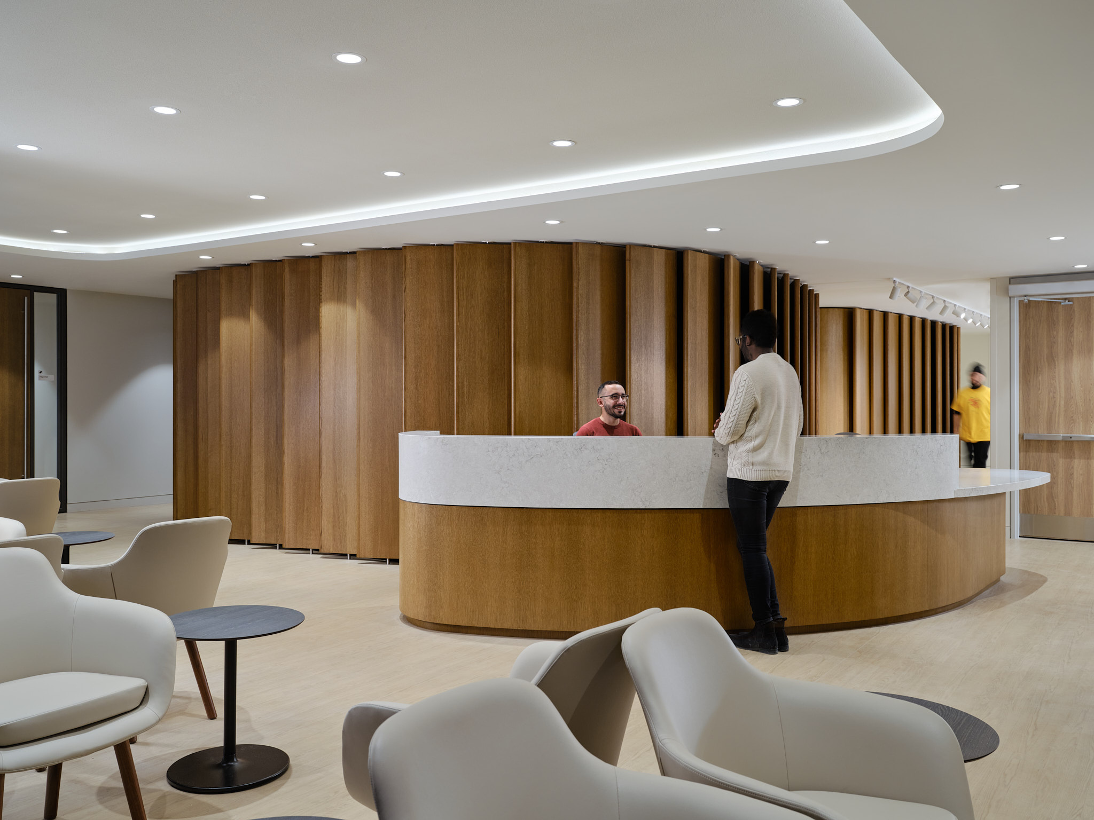
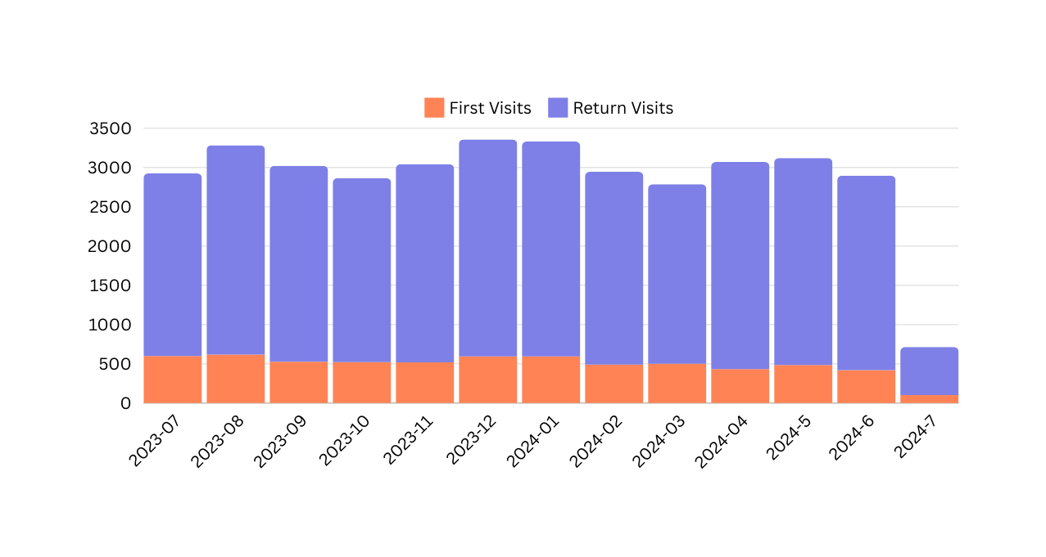
First vs Return
July 2023 - June 2024
04,725 visits in 2022
27,025 visits in 2023
18,986 visits in 2024
@myhqtoronto | hqtoronto.ca | hqtoronto.ca/donate

Slide 9
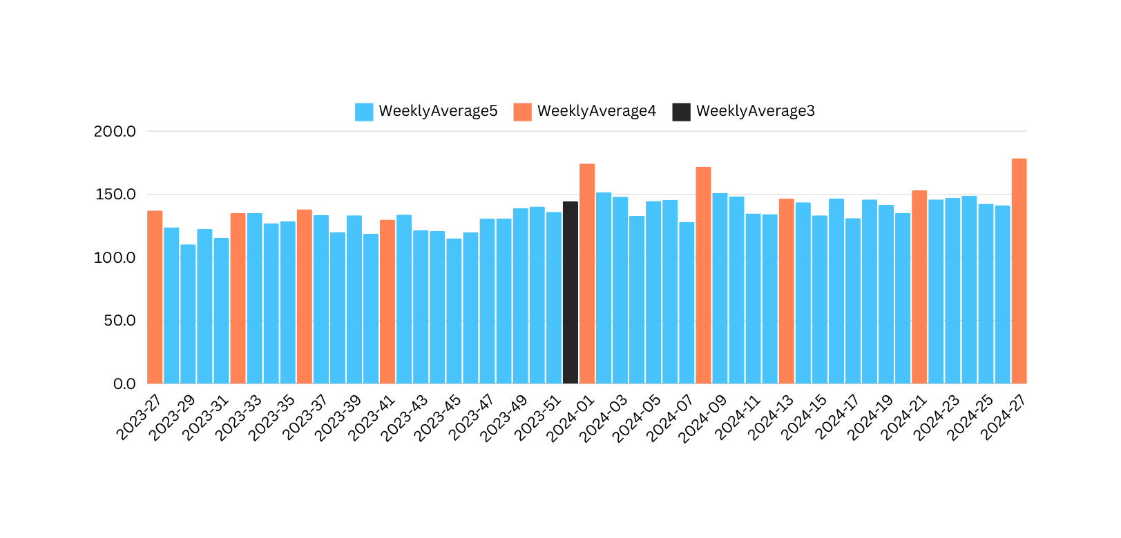
Average Weekly
July 2023 - June 2024
Christmas / Boxing Day
Canada Day
Civic Holiday
Labour Day
Thanksgiving
New Year
Family Day
Good Friday
Victoria Day
Canada Day
@myhqtoronto | hqtoronto.ca | hqtoronto.ca/donate

Slide 10






Demographics
July 2022 to June 2024
Average age of 34
10% living with HIV
Cis men: 87%
Trans men: 0.9%
Trans women: 1.4%
Non binary: 5.6%
Other gender identity : 1.5%
@myhqtoronto | hqtoronto.ca | hqtoronto.ca/donate

Slide 11

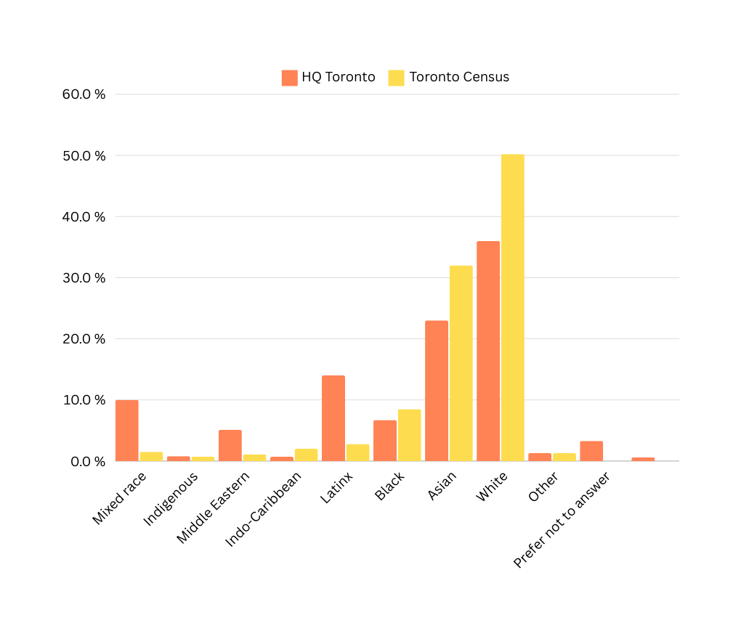
Ethnicity by individuals
July 2022 to June 2024
@myhqtoronto | hqtoronto.ca | hqtoronto.ca/donate

Slide 12
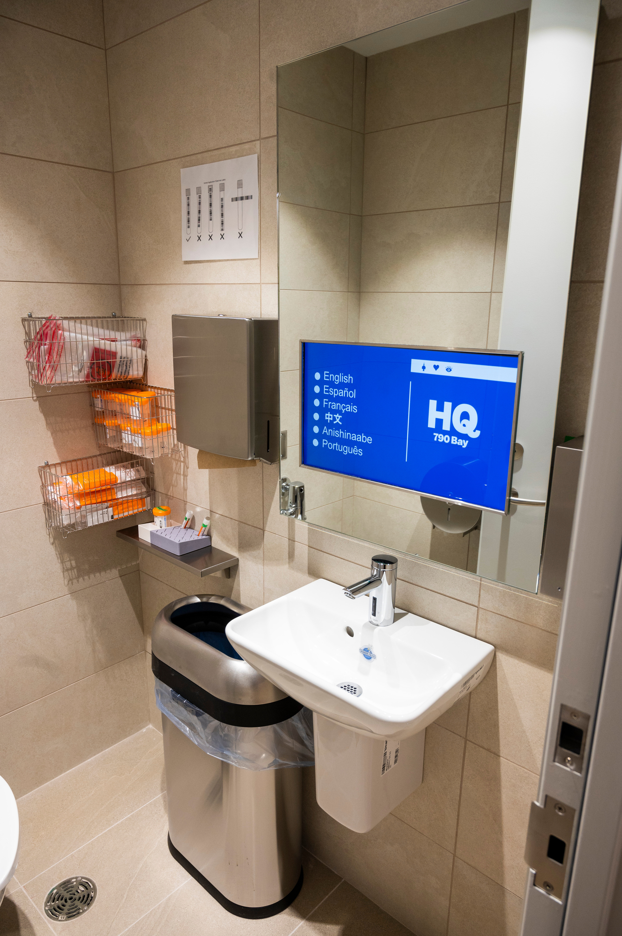
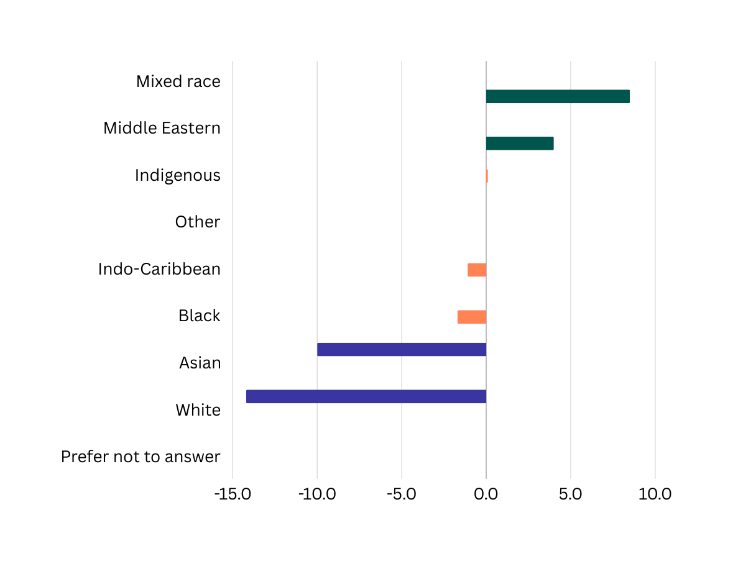

Ethnicity
(Difference between Toronto 2020 Census and HQ
<Toronto Census
= Toronto Census
> Toronto Census

Slide 13
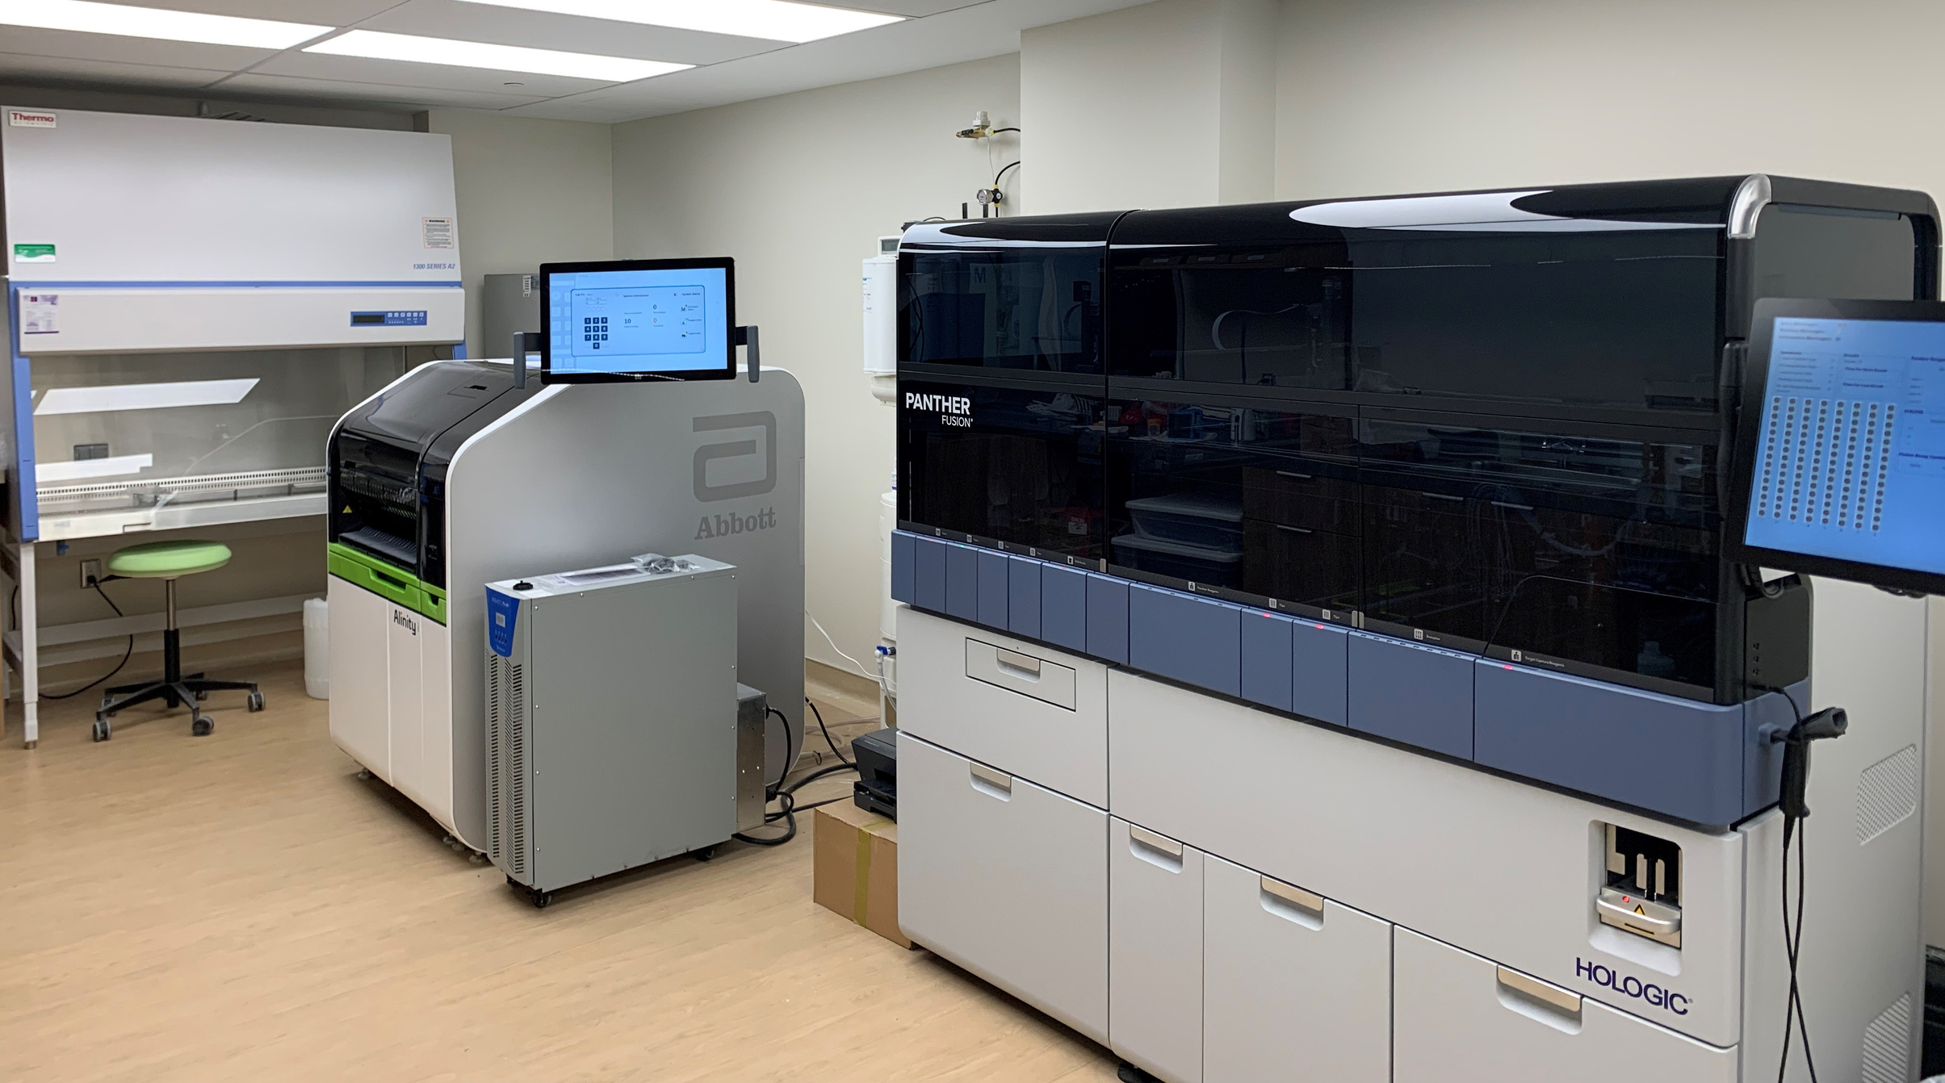
Improving the Health of Our Community
239,720 Test results
39,234 Treatment
@myhqtoronto | hqtoronto.ca | hqtoronto.ca/donate

Slide 14
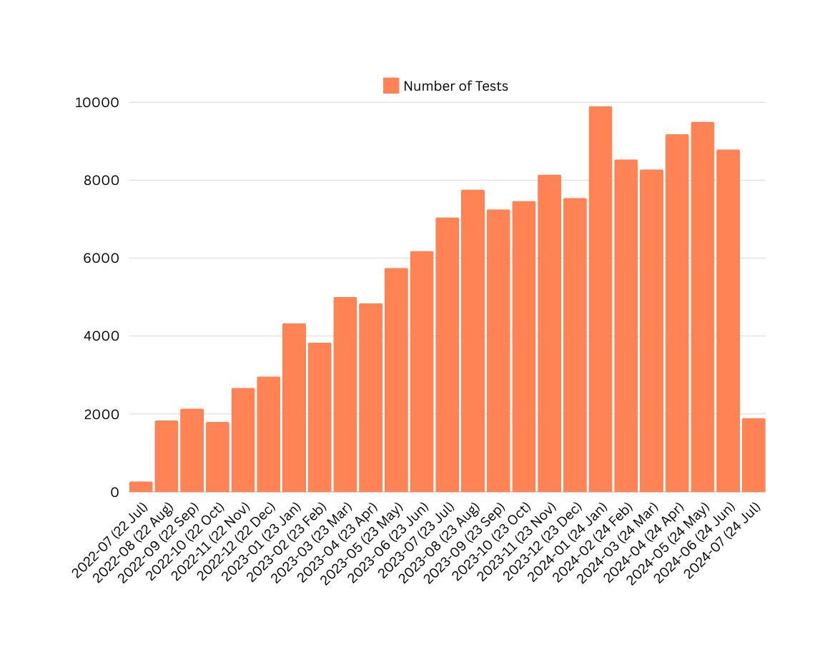
{{{{{{{{{{{{
STBBI Testing- Overall
Overall Numbers
@myhqtoronto | hqtoronto.ca | hqtoronto.ca/donate

Slide 15
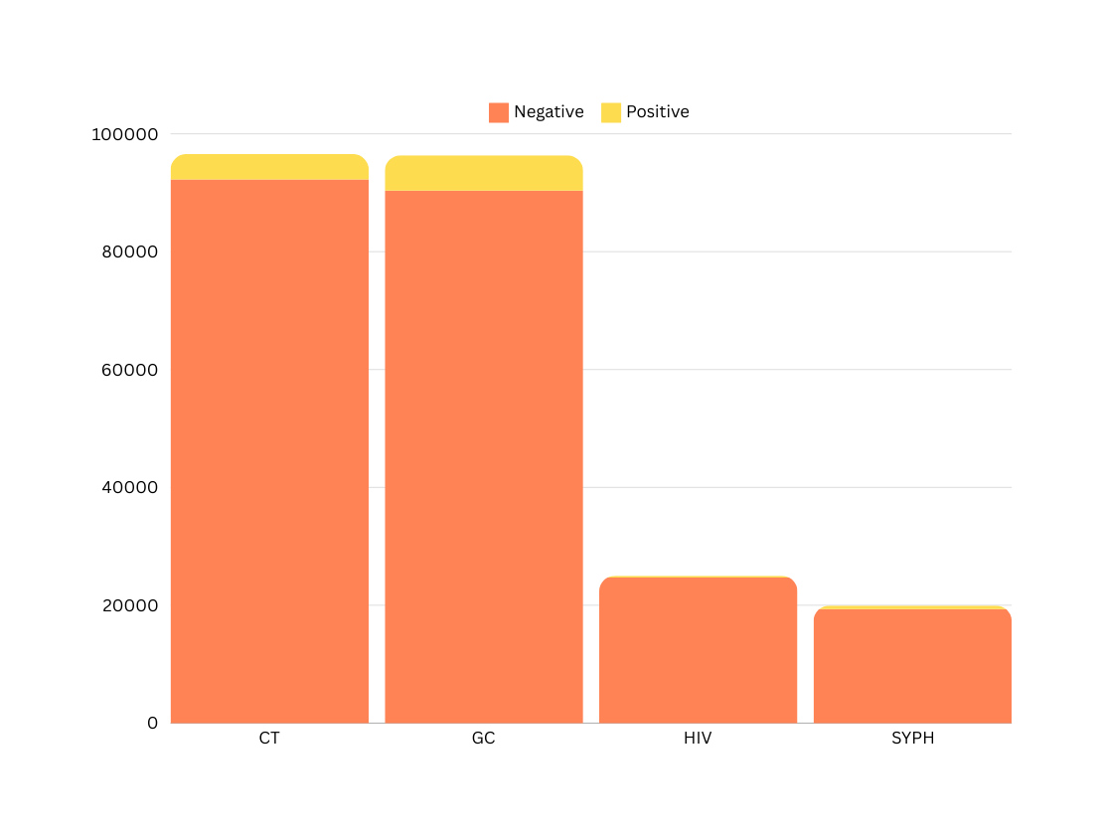
{{{{{{{{{{{{
STBBI Testing
4303
6017
318
606
@myhqtoronto | hqtoronto.ca | hqtoronto.ca/donate

Slide 16
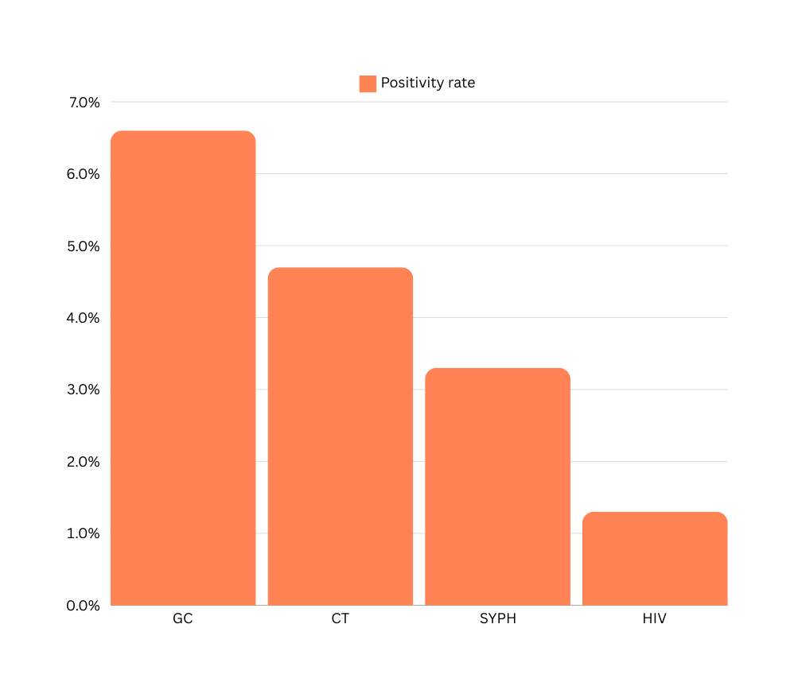
{{{{{{{{{{{{
Positivity Rate
July 2022-June 2024
6.2%
4.5%
3.0%
1.3%
@myhqtoronto | hqtoronto.ca | hqtoronto.ca/donate

Slide 17
{{{{{{{{{{{{
June 2024
Per Test Cost
 | Cost / Test | Test Volumes | Labour cost / Test | July Total Cost / Test
HIV Ag/Ab Combo Assay | $1.85 | 1618 | $ 2.39 | $ 4.24
Syphilis TP Assay | $ 1.34 | 1293 | $ 2.39 | $ 3.73
Aptima Combo 2 | $9.50 | 5868 | $ 2.39 | $ 11.89
HIV-1 QuantDx | $25.00 | 12 | $ 2.39 | $ 27.39
@myhqtoronto | hqtoronto.ca | hqtoronto.ca/donate

Slide 18
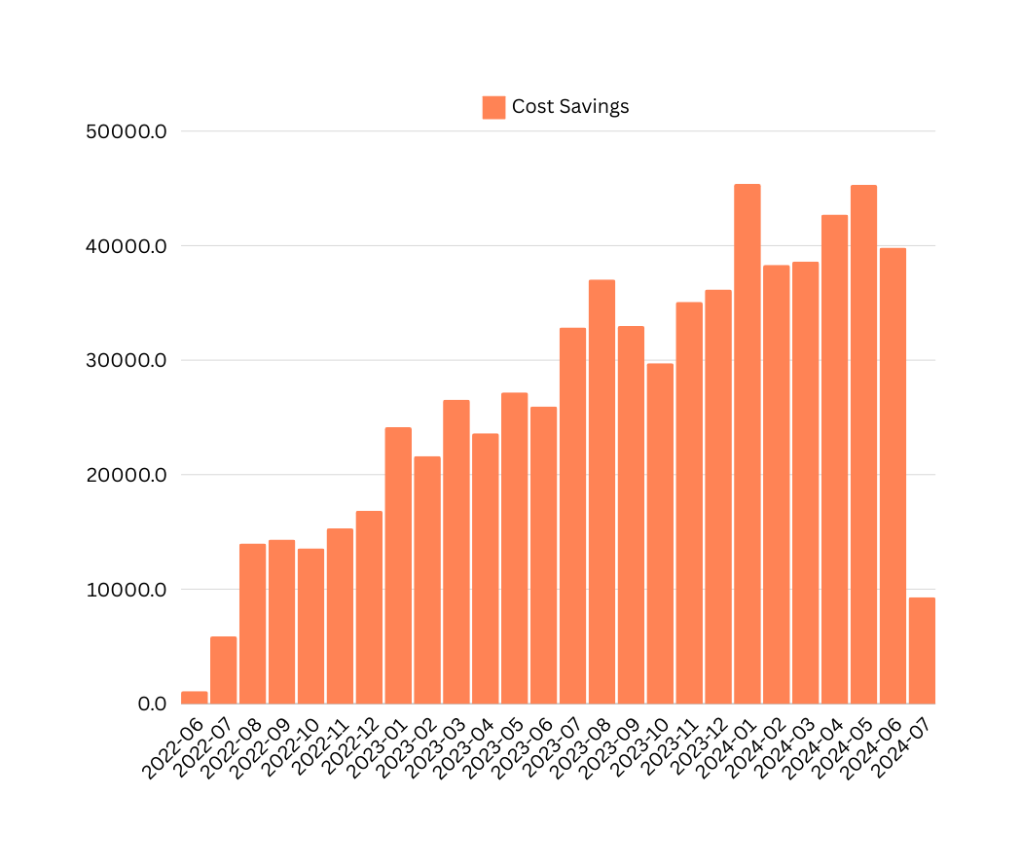
Monthly Cost Savings from Express Testing
Total cumulative savings to-date
$538,282
@myhqtoronto | hqtoronto.ca | hqtoronto.ca/donate

Slide 19

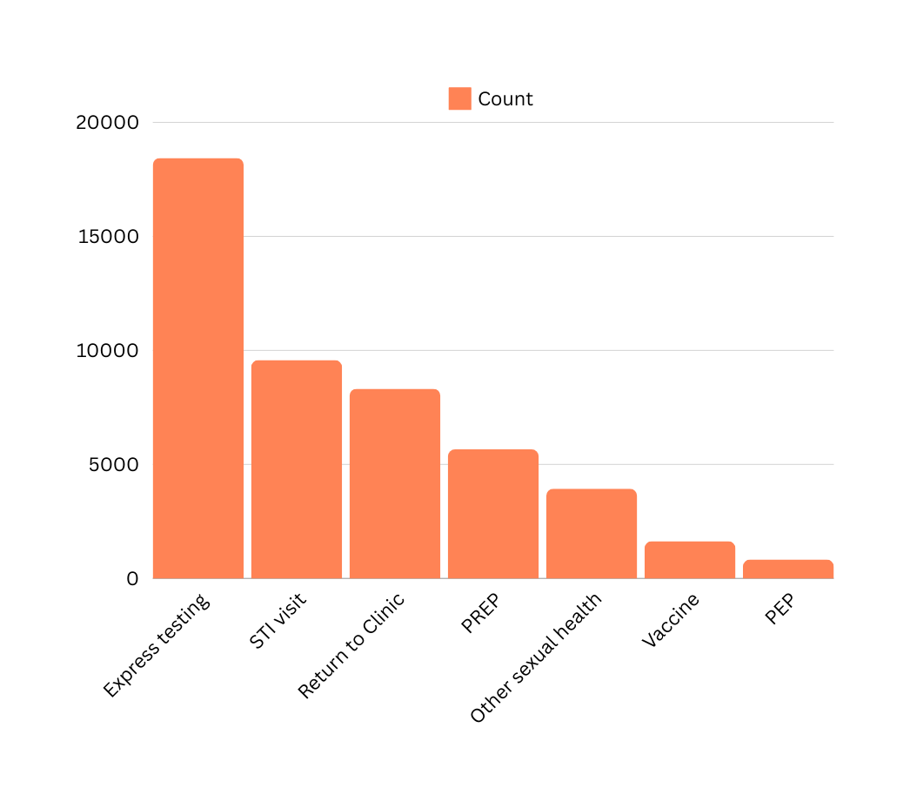
Reasons for Visit
July 2022 - June 2024
What individuals indicate on the kiosk as the reason for their visit
@myhqtoronto | hqtoronto.ca | hqtoronto.ca/donate

Slide 20

Unmet STBBI Needs
July 2022 - June 2024
2150 uninsured or precariously insured individuals accessing care at HQ (no OHIP or IFH)
2028 STBBIs diagnosed and treated amongst uninsured individuals
1321 gonorrhea or chlamydia
604 syphilis
2770 treatments given to 1212 service users (includes empiric treatments)
@myhqtoronto | hqtoronto.ca | hqtoronto.ca/donate

Slide 21

Unmet HIV Needs
July 2022 - June 2024
330 individuals with no OHIP, living with HIV receiving their HIV care at HQ
@myhqtoronto | hqtoronto.ca | hqtoronto.ca/donate

Slide 22

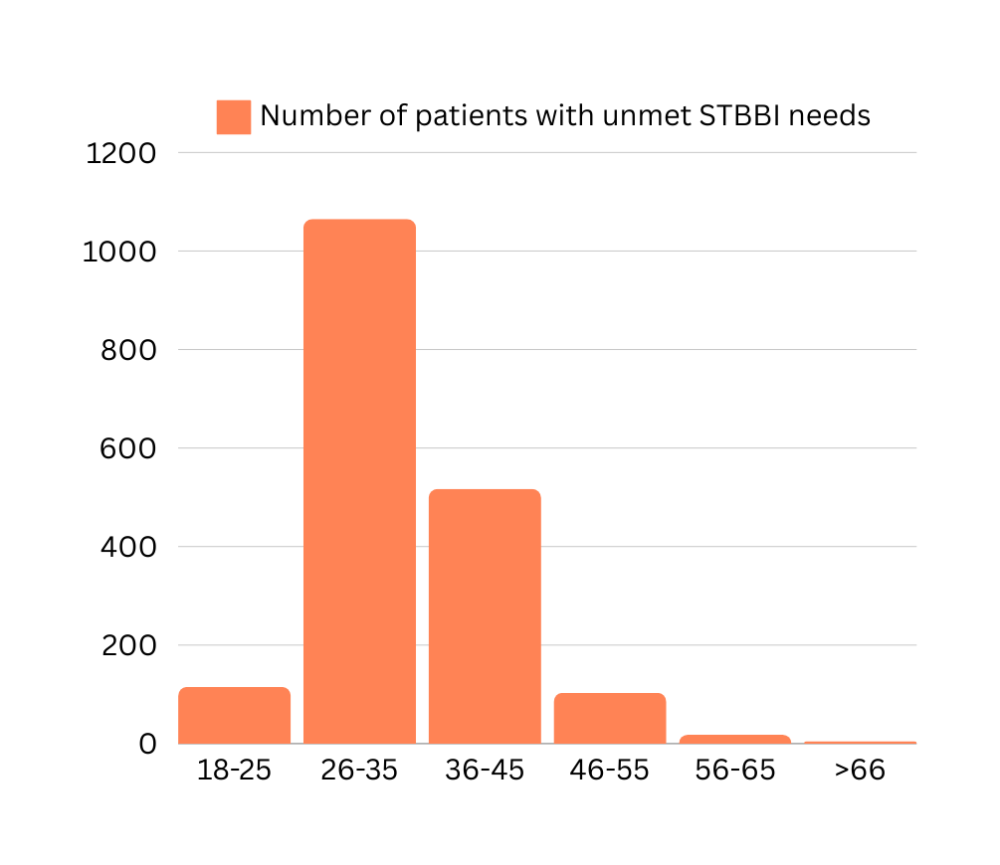
Unmet STBBI Needs: Age
Number of individuals
@myhqtoronto | hqtoronto.ca | hqtoronto.ca/donate

Slide 23

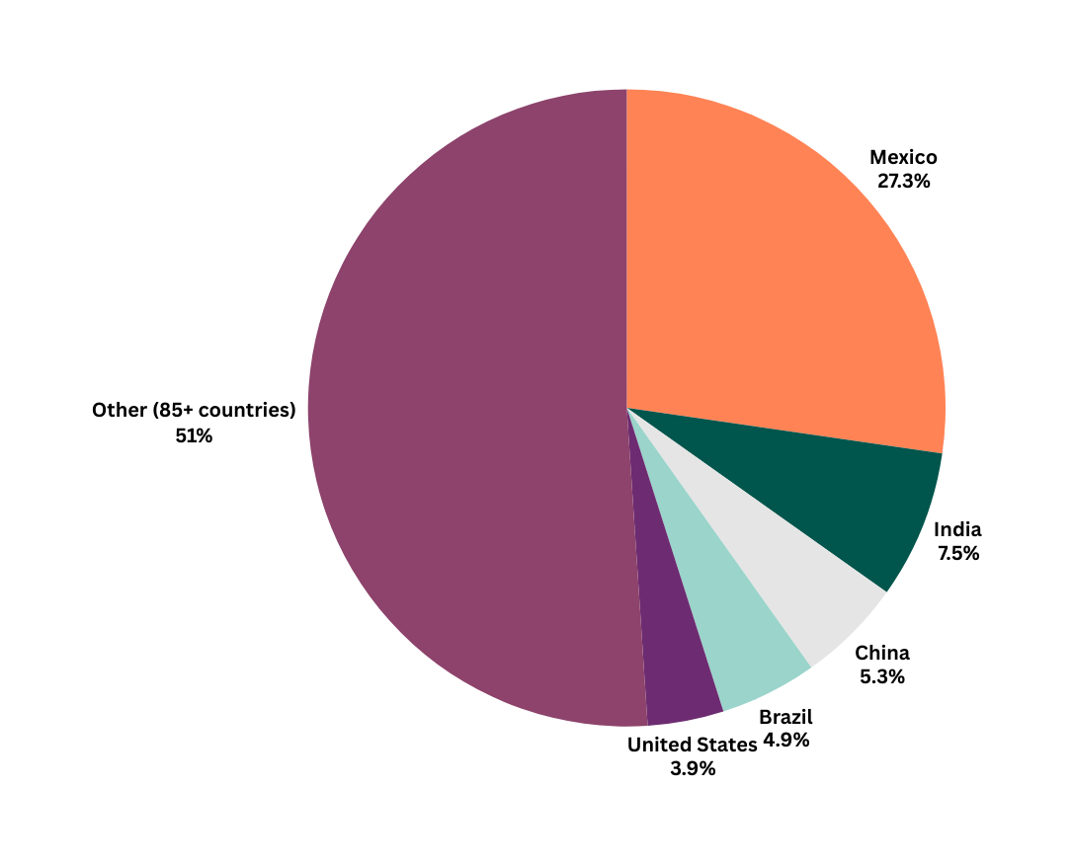
{{{{{{{{{{{{
Unmet STBBI Needs: Country of Origin
Other countries of origin (individuals): Ukraine, Saudi Arabia, Peru, Barbados, Thailand, Cyprus, Hungary, Venezuela, Germany, South Korea, Spain, France, Uganda, Nigeria, Guyana, Ghana, Panama, Australia, Jamaica, Pakistan
@myhqtoronto | hqtoronto.ca | hqtoronto.ca/donate

Slide 24

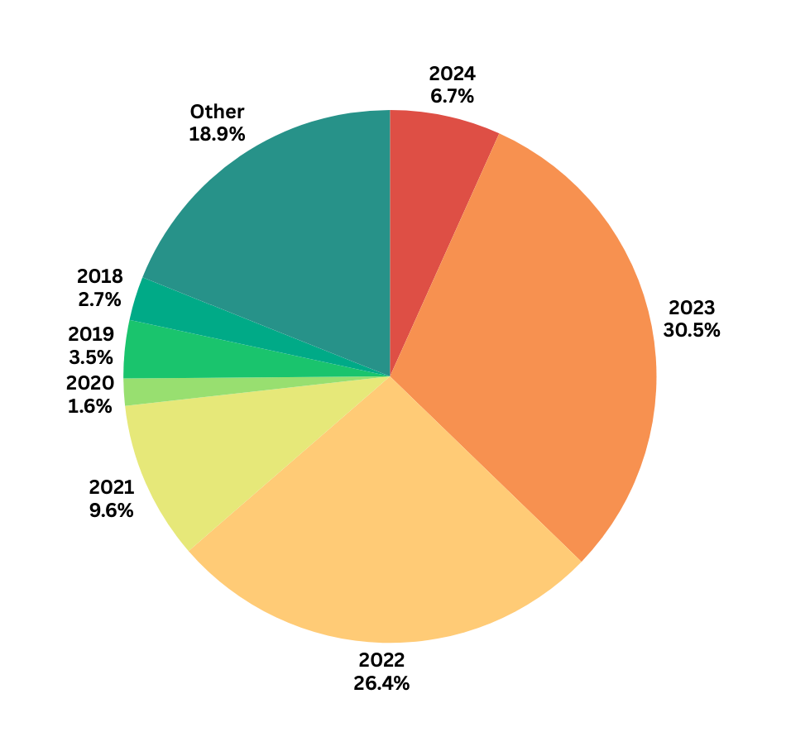
{{{{{{{{{{{{
Unmet STBBI Needs: Year of Arrival in Canada
@myhqtoronto | hqtoronto.ca | hqtoronto.ca/donate

